Slide 1
Predict Attrition with Machine Learning
Capstone Project

Slide 2
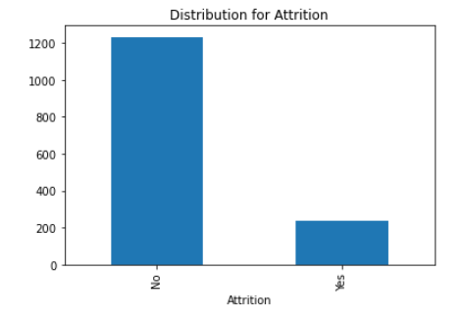
Study Objectives
Attrition rate is high at 16.1% (237 out of 1470 staff)
This study aims to:
Find out factors that lead to employee attrition
Predict staff that may be leaving for management intervention
Fictional dataset 1470 x 35 from Kaggle

Slide 3
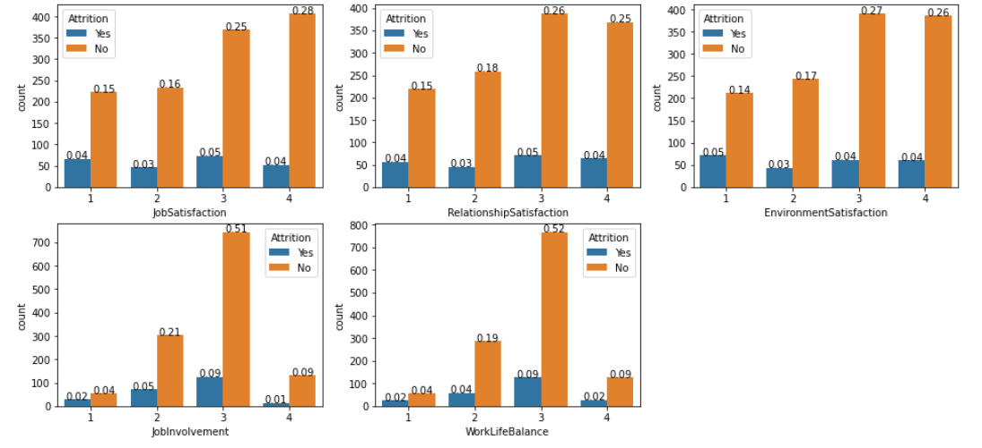
Exploratory Data Analysis (EDA) - Satisfaction type features
Resigned staff looks even across satisfaction levels, disparity not as obvious as expected
Those who rated these features low have a slightly higher chance of leaving the company
Notes:
It is very possible that dissatisfied staff did not indicate their true thoughts during data collection.
Hence, we cannot just look at satisfaction type features.
Remove labels.

Slide 4
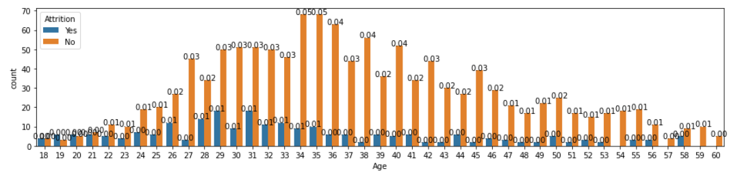
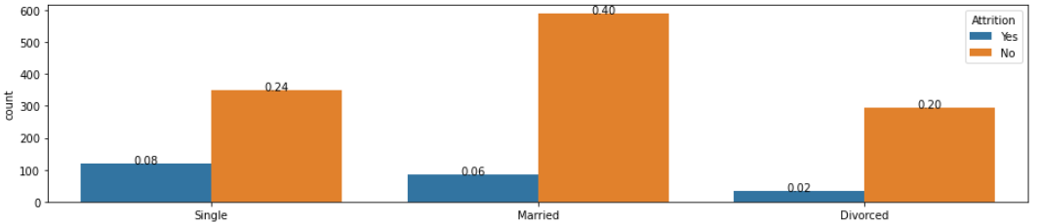
Exploratory Data Analysis (EDA) - Staff personal profile
Higher attrition in people 31 and younger (except aged 27)
Higher attrition in Singles
Notes:
Younger people trying out jobs. More likely to leave.
Singles without family commitments also leave companies more easily, less concerned with job stability.

Slide 5
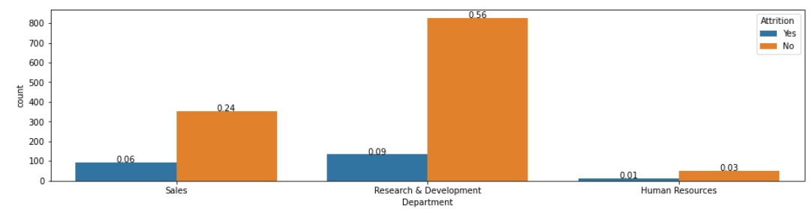
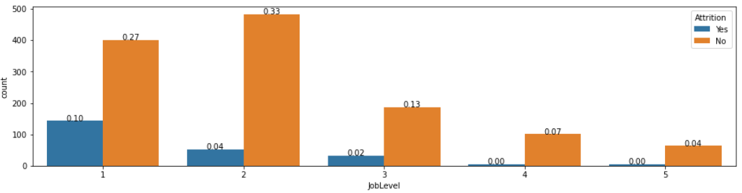
Exploratory Data Analysis (EDA) - Staff work profile – part 1
Higher attrition in Sales and HR than in R&D
Higher attrition in Job Levels 1 and 3
Notes:
Higher attrition in Sales and HR. Could it be due to nature of job? Sales is more volatile.
HR and Sales smaller groups in the company. Likely R&D is a big part of the business and more focused on. HR maybe feels underappreciated?
Higher attrition in lower Job Levels. Do the staff feel underappreciated? Unhappy with supervisors? Next slide may provide some clues.

Slide 6
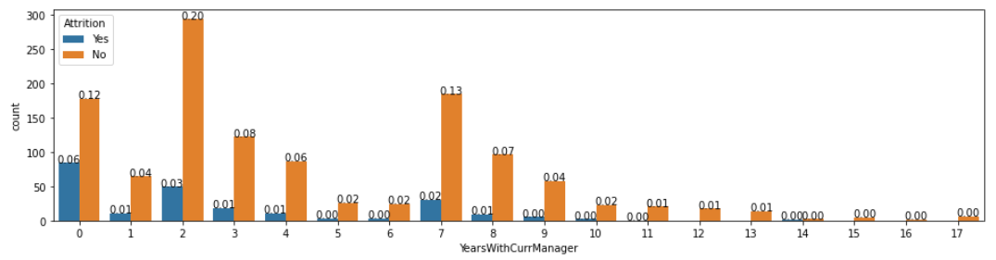
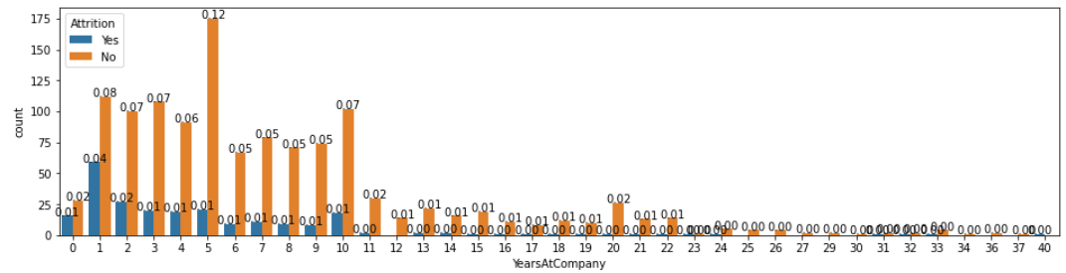
Exploratory Data Analysis (EDA) - Staff work profile – part 2
Higher attrition for those who have new supervisors
This chart shows those at 0 YearsWithCurrManager are not all new hires
Notes:
Many people leave after changing supervisors. Do supervisors that require more training to be more effective in communication with their team?

Slide 7
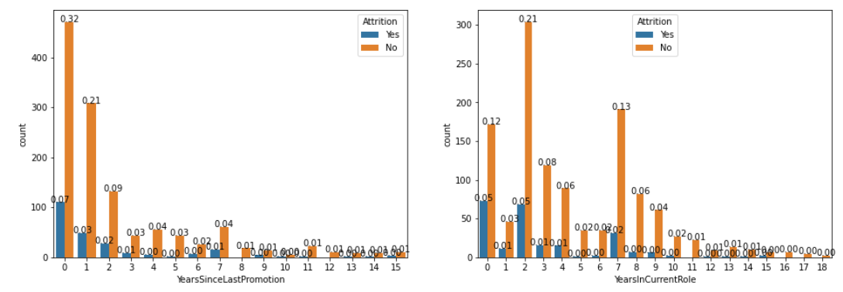
Exploratory Data Analysis (EDA) - Staff’s career progression
Quick promotion in company, staff leaving soon after
Job rotation seems to happen after 2 years in current role. Staff leaves soon after rotation
Notes:
Is promotion too fast?
Is job rotation putting staff in jobs that do not have good fit with their skills/interests? Job rotation too fast?

Slide 8
Exploratory Data Analysis (EDA) - Summary
May potentially look into :
Retaining younger staff
Job motivation for staff at lower job level
Supervisory practices and communication
Rate of promotion
Rate of job rotations and also, job fit

Slide 9
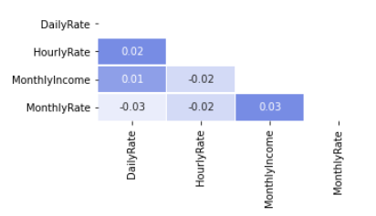
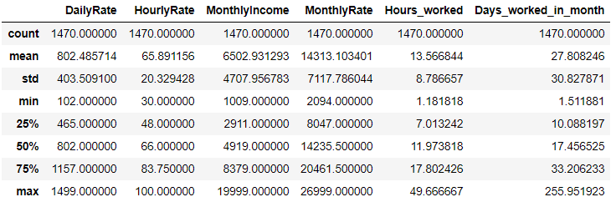
Dataset - Data cleaning
Data already relatively clean
Removed variables with no variance (EmployeeCount, Over18, StandardHours)
Checked for correlated variables > 0.9
Removed data that doesn’t make sense (DailyRate, HourlyRate, MonthlyRate)
Almost 0 correlation

Slide 10
Feature Selection - Methods used
Data split : 80% for training; 20% for testing
After getting dummy variables, there are 55 variables.
Target variable : whether staff has left
Techniques attempted:
Variance Threshold
SelectKBest
RFECV
L1 penalty (L2 penalty did not remove any features)
Random Forest Classifier
Notes:
Out of the 55 variables, what are those that will help explain the variance between the 2 classes – staff who are still around, and those who left?

Slide 11
Feature Selection - Results
Baseline : 0.8384
Scores (derived using simple Logistic Regression on selected features from different techniques) :
Technique | Score | No. of selected variables
SelectKBest | 0.8605 | 20
RFECV | 0.8843 | 44
Log Reg – L1 penalty | 0.8741 | 45
Random Forest | 0.8469 | 13
No feature selection | 0.8707 | 55
Notes:
Based on scores from fitting Logistic Regression to features selected from various methods, model built from RFECV features has the highest score. But this may be due to the higher number of variables, which could mean the higher score was from overfitting. I am not too comfortable with having so many variables in my model too.
To overcome having too many variables, I will try to merge another feature selection technique with Log Regression (L1 penalty), which has the second highest score. I've decided to try using SelectKBest, which is a filter-based methods that pick up the intrinsic properties of the features. Then apply L1 penalty to the selected features. I will build these 2 techniques as a pipeline and perform GridSearchCV on the pipeline for optimal hyperparameters.
For Random Forest technique, score is lower maybe because few variables are selected. I will build a model using Random Forest classifier for comparison later with the SelectKBest+LogReg model.
I have not chosen RFECV because its goals is somewhat similar to L1 penalty method, choosing based on optimising the model. If I merge RFECV and Log Reg with L1, it is likely I end up with many features in my model and risk overfitting.

Slide 12
Data Modelling - 4 models tested
Baseline : 0.8384
1. Logistic Regression (L1 penalty) Score : 0.8707 Hyperparameters: penalty=‘L1', solver='liblinear', cv=3, max_iter=1000 | 2. Logistic Regression (L2 penalty) Score : 0.8707 Hyperparameters: penalty=‘L2', cv=3, max_iter=1000
3. Random Forest Classifier Score: 0.8299 Hyperparameters (from GridSearchCV): max_depth=15, max_features='log2', n_estimators=200 | 4. SelectKBest + Logistic Regression Score: 0.8809 Hyperparameters (from GridSearchCV): SelectKBest - k=35 LogisticRegression - C=464.1588833612773, max_iter=2000, penalty='l1', solver='liblinear’

Slide 13
Data Modelling - Classification Reports
Baseline : 0.8384
1. Logistic Regression (L1 penalty) | 2. Logistic Regression (L2 penalty)
3. Random Forest Classifier | 4. SelectKBest + Logistic Regression
Class | Precision | Recall | F1-Score
0 | 0.89 | 0.97 | 0.93
1 | 0.68 | 0.36 | 0.47
Class | Precision | Recall | F1-Score
0 | 0.88 | 0.98 | 0.93
1 | 0.71 | 0.32 | 0.44
Class | Precision | Recall | F1-Score
0 | 0.85 | 0.97 | 0.91
1 | 0.50 | 0.09 | 0.14
Class | Precision | Recall | F1-Score
0 | 0.89 | 0.96 | 0.91
1 | 0.62 | 0.38 | 0.47
Notes:
- `Precision = True Positives / (True Positives + False Positives)`
- A precision score of 1 indicates that the classifier never mistakenly added observations from another class. A precision score of 0 would mean that the classifier misclassified every instance of the current class.
- `Recall = True Positives / (True Positives + False Negatives)`
- A recall score of 1 indicates that the classifier correctly predicted (found) all observations of the current class (by implication, no false negatives, or misclassifications of the current class). A recall score of 0 alternatively means that the classifier missed all observations of the current class.
- `F1-Score = 2 * (Precision * Recall) / (Precision + Recall)`
- The f1-score's best value is 1 and worst value is 0, like the precision and recall scores. It is a useful metric for taking into account both measures at once.

Slide 14
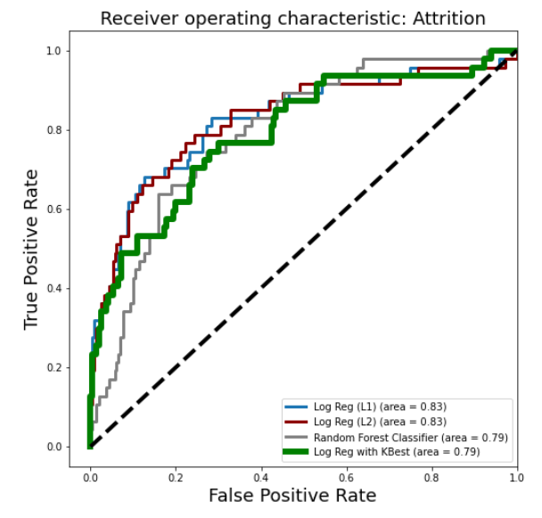
Data Modelling - AUC Chart
AUC for Model 1 and 2 are the highest but they have more variables (higher risk of overfitting)
AUC for Model 3 and Model 4 are the same but Model 3 (Random Forest) is very bad at predicting the attrition class.
Notes:
Different from what Sri saw earlier. I did not fit and test with scaled data earlier on.
The greater the area under the curve, the higher the quality of the classification model.

Slide 15
Data Modelling - First round ranking of models
Model 4 : SelectKBest + Logistic Regression (Least variables (35), decent at predicting attrition class)
Model 1 : Logistic Regression with L1 penalty (45 variables)
Model 2: Logistic Regression with L2 penalty (55 variables)
Model 3: Random Forest Classifer (15 variables but bad at predicting attrition class)

Slide 16
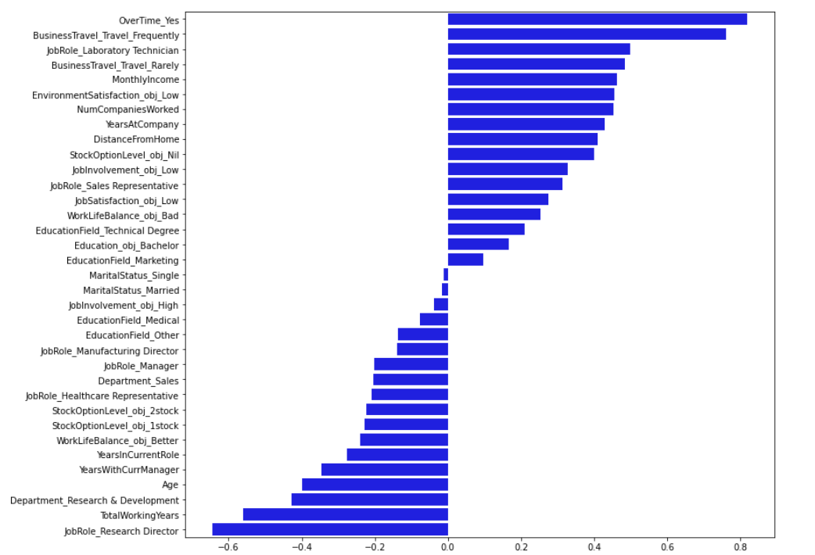
Factors that lead to attrition - From interim Model 4
Correlated variables:
YearsWithCurrManager & YearsatCompany - 0.77
YearsWithCurrManager & YearsinCurrentRole - 0.71
Notes:
Coefficients from Select Kbest + Log Reg. 35 variables.

Slide 17
Next Steps
Imbalanced data:
All models, even Model 4, are biased towards predicting non-attrition class, likely due to imbalanced data
Will use oversampling to tackle this issue
Feature Selection:
Relook at correlated variables
Attempt another model : SelectKBest, RFECV, then Logistic Regression
Final product : Best model will be used to build a portal for predicting staff likely to leave

Slide 18
Data Modelling - With Oversampling
Baseline : 0.8384
SelectKBest + Logistic Regression | SelectKBest + Logistic Regression (with OS)
Random Forest Classifier | Random Forest Classifier (with OS)
Class | Precision | Recall | F1-Score
0 | 0.89 | 0.96 | 0.91
1 | 0.62 | 0.38 | 0.47
Class | Precision | Recall | F1-Score
0 | 0.93 | 0.79 | 0.86
1 | 0.39 | 0.70 | 0.50
Class | Precision | Recall | F1-Score
0 | 0.85 | 0.97 | 0.91
1 | 0.50 | 0.09 | 0.14
Class | Precision | Recall | F1-Score
0 | 0.86 | 0.97 | 0.91
1 | 0.50 | 0.15 | 0.23
Notes:
- `Precision = True Positives / (True Positives + False Positives)`
- A precision score of 1 indicates that the classifier never mistakenly added observations from another class. A precision score of 0 would mean that the classifier misclassified every instance of the current class.
- `Recall = True Positives / (True Positives + False Negatives)`
- A recall score of 1 indicates that the classifier correctly predicted (found) all observations of the current class (by implication, no false negatives, or misclassifications of the current class). A recall score of 0 alternatively means that the classifier missed all observations of the current class.
- `F1-Score = 2 * (Precision * Recall) / (Precision + Recall)`
- The f1-score's best value is 1 and worst value is 0, like the precision and recall scores. It is a useful metric for taking into account both measures at once.

Slide 19
Thank you.

